Slide 1

WEATHER FORECAST
WEEKLY WEATHER BY K.MOTENO

Slide 2
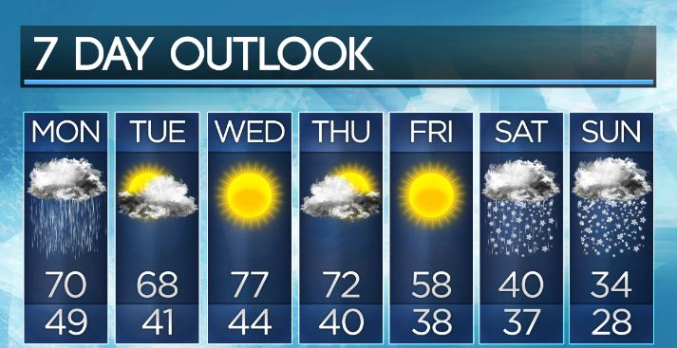
Overview
Weekly Temperature Tracker Application
The Weekly Temperature Tracker Application is a simple Android app developed using Kotlin. The app provides users with an overview of the average temperature for the week and detailed information about daily temperatures. The application's primary aim is to offer an intuitive and user-friendly interface for monitoring and analyzing temperature trends over a week
TREY
research

Slide 3
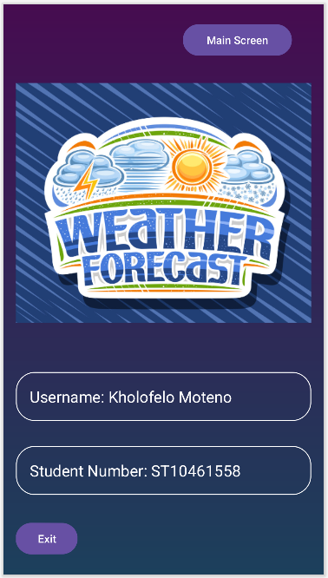
Login Page for registered users
First page will display the navigation to main screen or exit
TR

